Slide 1
Stacks and Queues
Data Structures
Ching-Fang Hsu
Department of Computer Science and Information Engineering
National Cheng Kung University

Slide 2
Introduction
The stack and the queue are both special cases of ordered list.
Given an ordered list A = a₀, a₁, …, a_{n-1}, each a_{i} is called an atom or an element.
  An empty list is denoted by ().

Slide 3
The Stack Abstraction Data Type
A stack is an ordered list in which insertions and deletions are made at one end called top.
Given a stack S = (a₀, …, a_{n-1}), we say that a₀ is the bottom element and a_{n-1} is the top element.
a_{n-1}
…
a₀

Slide 4
The Stack Abstraction Data Type (contd.)
Example: the sequence of insertion operations (p. 108, Fig. 3.1)
  A Last-In-First-Out (LIFO) list
The system stack is an application of the stack.
  Used at run-time to process function calls
  Activation records (AR) or stack frames: elements of the system stack
local variables
parameters
prev. AR ptr.
return address

Slide 5
The Stack Abstraction Data Type (contd.)
Each time when a subprogram is invoked, the invoking subprogram creates an AR and places it on top of the system stack (p. 109, Fig. 3.2).
  Initially, the AR for the invoked subprogram contains only a pointer to the previous AR and a return address.
    prev. AR ptr. -- pointing to the caller′s AR
    return address -- the location of the statement to be executed after the subprogram terminates
  If this subprogram invokes another one, the local variables, except those declared static, and the parameters of the caller are added to its AR.
  When this subprogram terminates, its AR is removed.

Slide 6
The Stack Abstraction Data Type (contd.)
ADT Stack is
objects: a finite ordered list with zero or more elements.
functions:
for all stack ∈ Stack, item ∈ element, maxStackSize ∈ positive integer
Stack CreateS(maxStackSize)::=
create an empty stack whose maximum size is
maxStackSize
Boolean IsFull (stack, maxStackSize) ::=
if (number of elements in stack == maxStackSize)
return TRUE
else return FALSE
Stack Push(stack, item) ::=
if (IsFull(stack)) stackFull
else insert item into top of stack and return
Boolean IsEmpty (stack) ::=
if (stack== CreateS(maxStackSize))
return TRUE
else return FALSE
Element Pop(stack) ::=
if (IsEmpty(stack)) return
else remove and return the element at the top of the stack.
The ADT specification of the stack structure (p. 110, ADT 3.1)
The easiest way to implement a stack is by using an one-dimensional array.
  e.g., stack[MAX_STACK_SIZE]
  stack[0] is the bottom and the ith element is stack[i-1]
  top -- an associated variable indicating the index of the top element in the stack; initial value is -1
Relevant implementations (p.109~111)
  push / pop

Slide 7
The Stack Abstraction Data Type (contd.)
  push: top = top + 1; data insertion
  pop: retrieving data; top = top - 1
  Extraordinary cases
    Underflow
    Overflow
Other applications of stacks
  A mazing problem (backtracking)
  Expressions evaluation

Slide 8
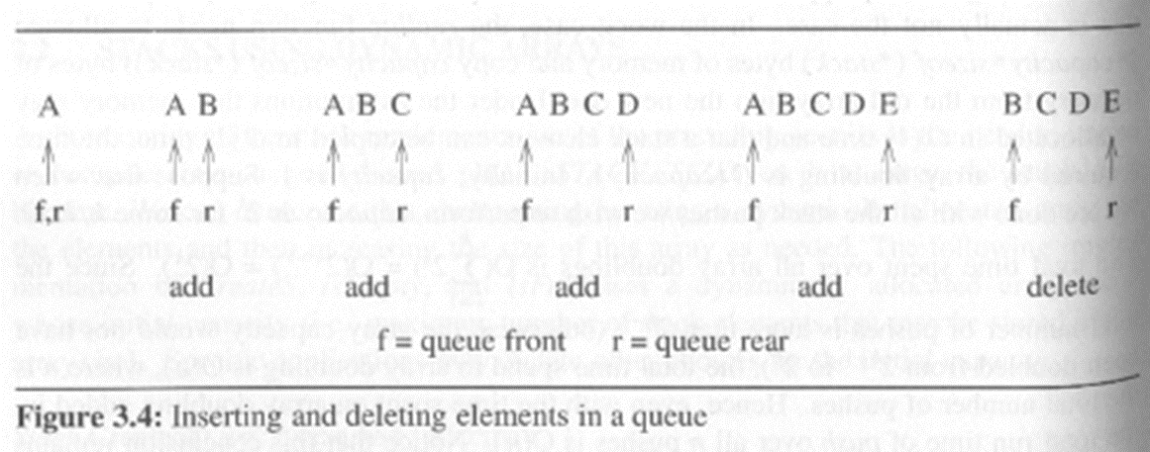
The Queue Abstraction Data Type
A queue is an ordered list in which all insertions take place at one end and all deletions take place at the opposite end.
Example: insertions and deletions (p. 114, Fig. 3.4)
The first element inserted into a queue is the first element removed.
  First-In-First-Out (FIFO) lists
a_{n-1}
…
a₀

Slide 9
The Queue Abstraction Data Type (contd.)
ADT Queue is
objects: a finite ordered list with zero or more elements.
functions:
for all queue ∈ Queue，item ∈ element，maxQueueSize ∈ positive integer
Queue CreateQ(maxQueueSize)::=
Create an empty queue whose maximum size is maxQueueSize
Boolean IsFullQ (queue, maxQueueSize)::=
if (number of elements in queue == maxQueueSize)
return TRUE
else return FALSE
Queue AddQ (queue, item) ::=
if (IsFull(queue)) queueFull
else insert item at rear of queue and return queue
Boolean IsEmptyQ (queue) ::=
if (queue == CreateQ(maxQueueSize))
return TRUE
else return FALSE
Element DeleteQ(queue)::=
if (IsEmptyQ (queue)) return
else remove and return the item at front of queue.
The ADT specification of the queue structure (p. 115, ADT 3.2)

Slide 10
The Queue Abstraction Data Type (contd.)
The simplest way to implement a queue is by using an one-dimensional array and two variables, front and rear.
  The front index is smaller than the index of the first-in element by one.
  The rear index points to the current end of the queue.
  The initial values are both -1 to indicate an empty state.

Slide 11
The Queue Abstraction Data Type (contd.)
  Implementation of operations (p. 114~116)
    insert (add) and delete
    insert: rear = rear + 1; data insertion
    delete: front = front +1; data retrieval
  When rear equals MAX_QUEUE_SIZE - 1, queue_full is triggered to move the entire queue to the left.
    The worst case complexity of queue_full is Ο(MAX_QUEUE_SIZE).
A variant: circular queues
  More efficient (p. 117, Fig 3.6, p.118~119)

Slide 12
The Queue Abstraction Data Type (contd.)
Data movement in queue_full
Circular queue
…
0
MAX_QUEUE_SIZE-1
rear
rear
rear
C
C
D
C
D
B
B
B
A
A
front
front
front

Slide 13
The Queue Abstraction Data Type (contd.)
當queue 滿了和空的時候rear 和front 都會指向一樣的位置
Implementation of circular queues
  The initial values of front and rear are 0 instead of -1.
  The front index always points one position counterclockwise from the first element in the queue.
  To distinguish between an empty and a full state, a circular queue of size MAX_QUEUE_SIZE can hold at most MAX_QUEUE_SIZE-1 elements.
解決方法：空下一格不放，所以當剩下一格時判斷為滿

Slide 14
The Queue Abstraction Data Type (contd.)
Other variants of queues
  Double-ended queues (dequeue)
  Priority queues
  Double-ended priority queues

Slide 15
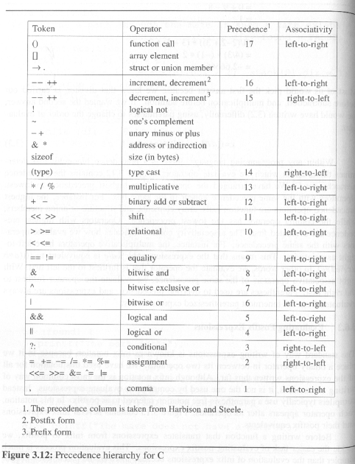
Evaluation of Expressions
Within any programming language, there is a precedence hierarchy of operators.
  C (p.130, Fig. 3.12)

Slide 16
Evaluation of Expressions (contd.)
Compilers typically use postfix notation for expressions evaluation.
  Parenthesis-free
Infix notation is the most common way of writing expressions, even for programmers.
So, compilers use a two-stage processing for expressions evaluation.
  Stage 1: Infix to postfix
  Stage 2: Evaluating postfix expressions
在兩個變數後面放運算符號
在兩個變數中間

Slide 17
Evaluation of Expressions (contd.)
Infix to postfix
  The order of operands is the same in infix and postfix.
    Operands are passed to the output expression.
  The order in which the operators are output depends on their precedence.
    Without consideration of parentheses
      Compare the precedence of top operator and that of incoming operator.
      If the latter is lower, pop the former and repeat this operation until the incoming operator has higher precedence than the stack top.
      At last push the incoming one into the stack
運算式出現的順序不會改變

Slide 18
Evaluation of Expressions (contd.)
    With consideration of parentheses
      in-stack precedence and incoming precedence
      The left parenthesis is a lowest-precedence operator on the stack while possessing highest precedence as an incoming one.
  p. 137, Program 3.15 (Θ(n), n: # of tokens)
所有的operator都會被放進去一次，被pop出來一次，而operand 則為直接輸出，
所以要執行2n次
每次放進stack的operator(Incoming Operator)和裡面目前最上面的operand作比較
，只要Incoming Operator沒有比stack 中最上面的operator 大(相等也算輸)
就要先把stack 最上面那個operator pop出來後再把Incoming Operator 放入
Stack 中

Slide 19
Evaluation of Expressions (contd.)
void postfix(void)
{/* output the postfix of the expression. The expression
string, the stack, and top are global */
char *symbol;
precedence token;
int n = 0;
int top = 0;
stack[0] = eos;
for (token = getToken(&symbol, &n); token != eos;
token = getToken(&symbol, &n)) {
if (token == operand)
printf(”%c”, symbol);
else if (token == rparen){
/* unstack tokens until left parenthesis */
while (stack[top] != lparen) //看到左括弧前繼續執行)
printToken (pop());
pop(); /* discard the left parenthesis*/
}
else {
/* remove and print symbols whose isp is greater
than or equal to the current token’s isp */
while (isp[stack[top]] >= icp[token])
//在看到incoming 比stack中的top 高之前 把stack裡面的值pop出來
printToken(pop());
push(token);
}
}
while ( (token = pop()) != eos)
//把剩下stack裡面的元素pop出來
printToken(token);
printf(”\n”);
}

Slide 20
push
a
b
c
+
a + b * c
*
push
pop
當放＊時看到+號，因為＊的
Priority較高所以直接push 到 stack中
pop
*
+
一開始scan時就先分成Operand(a,b,c…) 和 Operator 兩種來處理，
看到Operand可以直接輸出 ，-而Operator 則用stack的方式依序再放回

Slide 21
push
push
a
b
c
+
*
d
*
a * ( b + c ) * d
push
pop
1. 因為(它的precedence 比所有人都高，
所以就先push 到stack中。
2. 在放入stack的 ( 為了可以再看到
右括弧之前能接收到裡面全部的
operand，所以它的precedence
會比所有人都小，所以+ 被push
到stack中
3. 看到右括號後便開始pop其中的所有
Operand 直到看到左括號結束。
4. 接下來看到後面d之前的*，因為這個要放進來
的＊(incoming operand)和放在stack 裡面的＊比
precedence沒有贏(平手)，所以先把stack 裡面的＊push 出來後，再把
d的＊push 到stack中
+
pop
pop
pop
(
*

Slide 22
Evaluation of Expressions (contd.)
如何計算postfix?
Evaluating postfix expressions
  The operands are stored on a stack until they are needed. (看到operand 先放到stack 中，直到看到operator 出現，把operand 的stack兩個operand pop出來加上operator計算，算完後再把暫時運算結果再push回stack中)
  For an operator, remove two operands from the stack, perform the specified operation, and then push the result back to the stack.

Slide 23
Multiple Stacks
如何將多個stack存入一個array中
Two stacks only
  A stack grows upwards and the other one is toward the opposite direction.
  Overflow check
MEM_SIZE -1
0

Slide 24
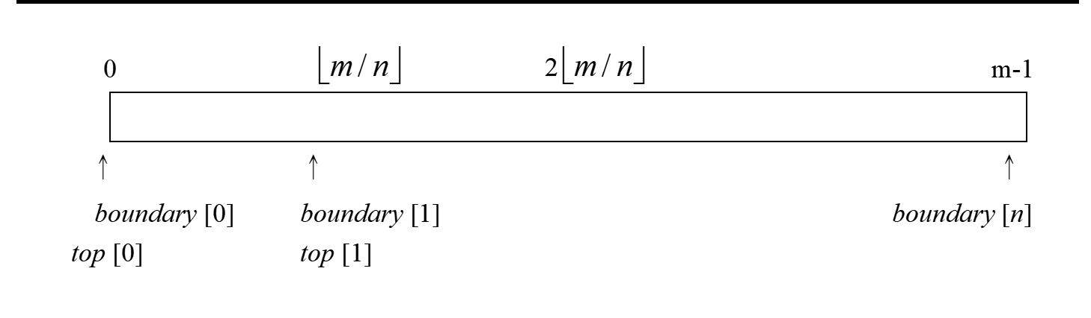
Multiple Stacks (contd.)
More than two stacks
  Divide the available memory into n segments.
    In proportion to the expected sizes of the various stacks
    Equal segments (p. 140, Fig. 3.18)
  Problem: Some stack i overflows while there are free space in the array.
    Local overflow, but not global overflow
    Solution 1: Moving stacks with ID greater than i to the right as possible (p.140, (1)).
    Solution 2: Moving stacks with ID smaller than i to the left as possible (p.141, (2)).
Array有m個位置分給n個stack

